Slide 1
MEMBER PROTECTION ROADSHOW
Craig Beed – Member Engagement & Operations Manager

Slide 2
Background
March 2017
August – September 2017
Deliver MP Awareness Training
June 2016
Association Health Check
October 2016
OoS Grant Application Member Protection Roadshow
February 2017
Grant Approval
April 2017
Engagement of Morgan Lander
Morgan Lander designs simplified MP Awareness Training

Slide 3
Roadshow Format
At location selected by Assn
At time selected by Assn
2hr session
No group too small

Slide 4
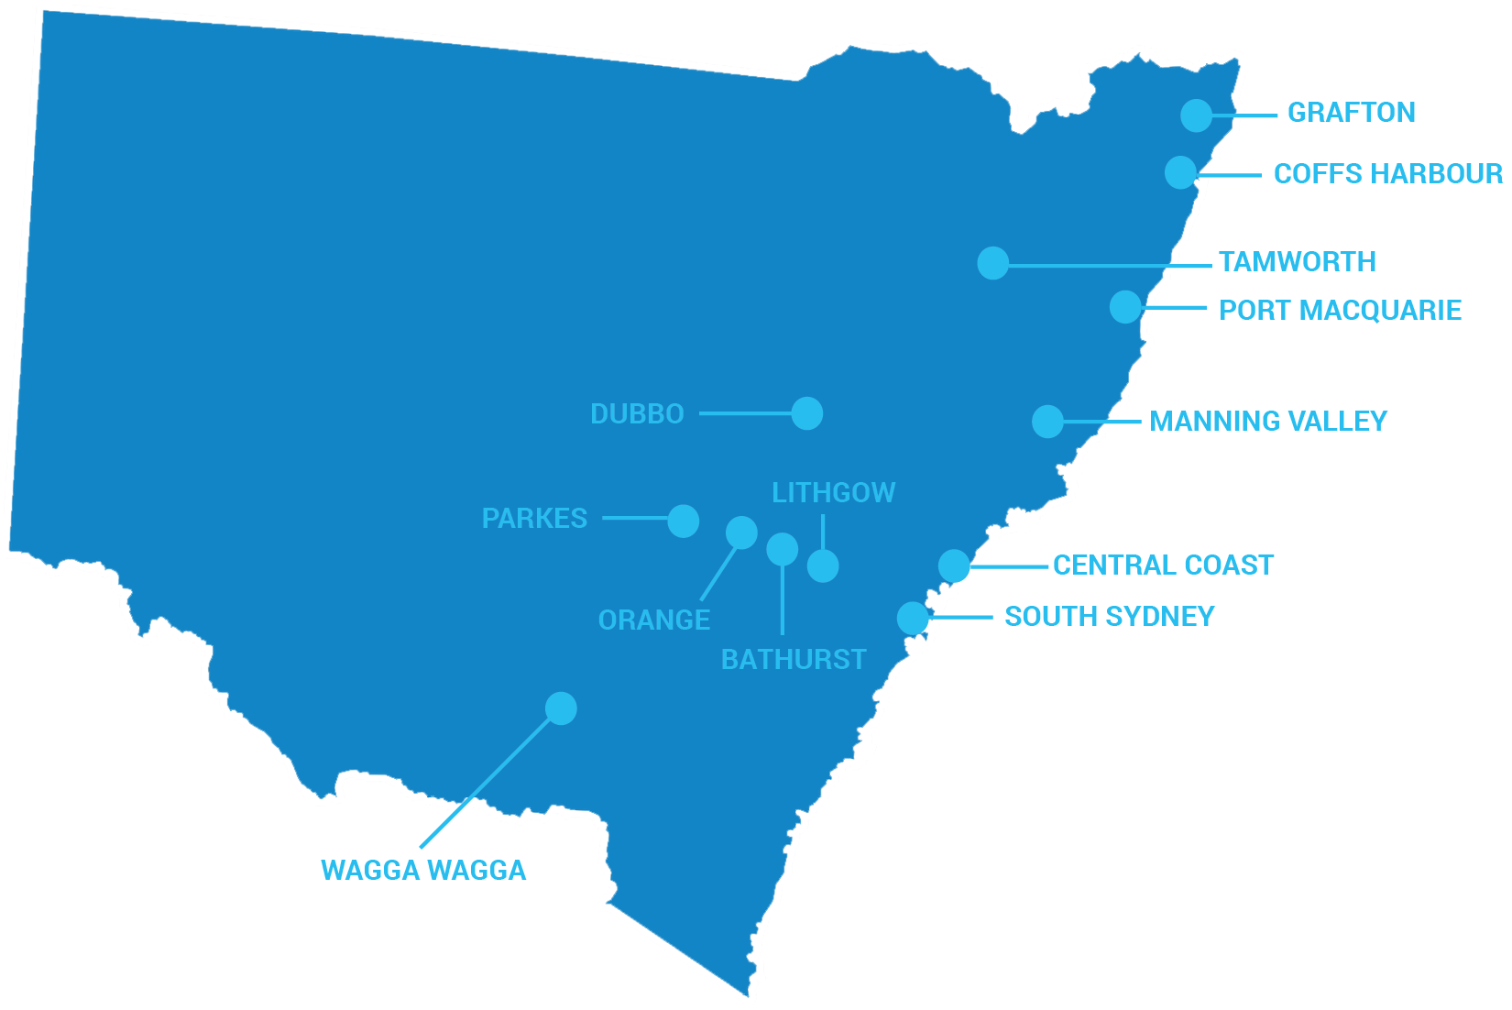
Training Locations
1 x Metro
12 x Regional

Slide 5
Key Stats

Slide 6
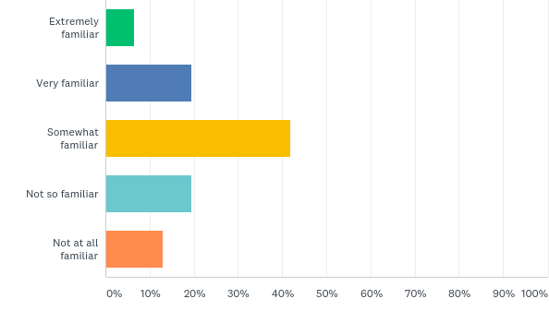
Post-Training Survey
Q: Prior to the Member Protection awareness training, how familiar were you with Member Protection in Sport?
74% with low familiarity of Member Protection in Sport

Slide 7
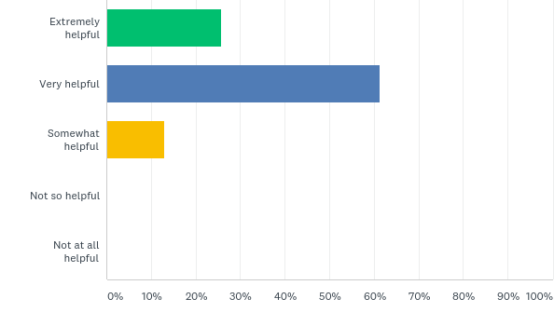
Post-Training Survey
Q: How helpful was the content presented at the training?
86% VERY POSITIVE

Slide 8
Key Observations
Decline in respect for OFFICIALS
01
Very small number of passionate VOLUNTEERS run hockey & wear multiple hats
02
Considerable number of OFFICE BEARER vacancies at Associations
03

Slide 9
Key Observations
04
05
06
Inexperience dealing with JUDICIARY & CONSITUTION significant concern for volunteers
Lack of understanding and or misunderstanding of WORKING WITH CHILDREN CHECK
Great stories of INCLUSION

Slide 10
Next Steps
01
02
03
New MEMBER PROTECTION POLICY (MPP) based on ASC and roadshow feedback
New template CONSTITUTION that aligns with new member protection policy
RESPECT FOR OFFICIALS campaign for 2018 season

Slide 11
MEMBER PROTECTION AWARENESS TRAINING

